Slide 1
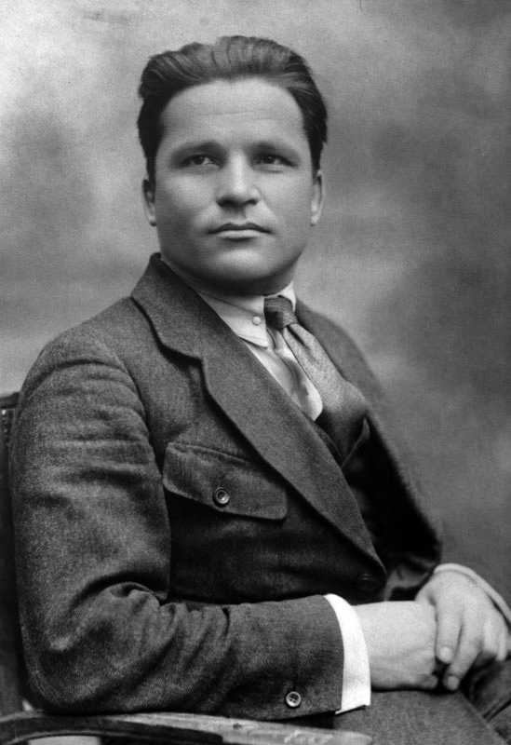
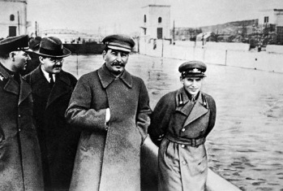
What sort of opposition to Stalin had developed before 1934?
L/O – To assess the significance of opposition to Stalin before 1934

Slide 2
Stalin’s Russia: 1924-1953
Origins and Rise of Stalin
Historical Context of Stalin’s Rise
Key Stages of the Power Struggle
Why did Stalin emerge as leader? (Essay)
Ideology and Nature of Stalin’s State
What role did ideology play in Stalin’s rise to power?
Was Stalin’s ideology in line with that of Marx and Lenin?
Was Stalin’s state totalitarian? (Timed Essay)
Establishment and Consolidation of Stalin’s Rule
How did the Great Purge 1936-39 help establish Stalin’s power?
How can the Great Terror be explained?
Was Stalin’s Personality responsible for the Great Terror? (Essay)
What other methods did Stalin use to maintain power?
Domestic Policies and their Impact
Main features of Collectivisation and Five-Year Plans
How successful were Stalin’s economic policies? (Timed Essay)
Position of Women
Education, Young People and the Arts

Slide 3
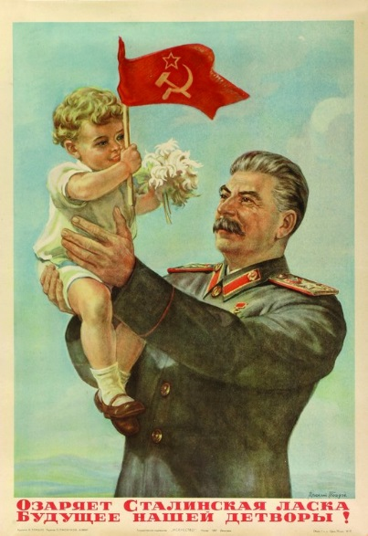
How did Stalin control the USSR?
During the 1930s, Stalin extended his control of the Communist Party and the people of the USSR, using the machinery of state terror.
In the mid 1930s, Stalin ordered the Great Purges which applied terror to the Communist Party itself. Old Bolsheviks were removed and anyone who showed signs of dissent were sent to prison camps. Millions were murdered.
He also used a ‘cult of personality’ and propaganda that create a god-like leader image. Stalin was feared and loved.

Slide 4
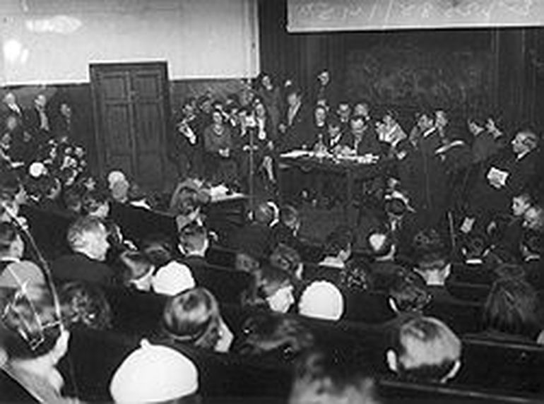
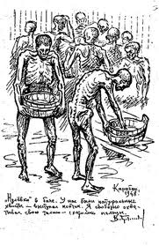
What are Purges?
‘Purge’ refers to ‘cleaning out’ or ‘cleansing’ an organism of impurities. The first purge in the Communist Party took place in 1918 and there were many throughout the 1920s.
A Chistka (cleansing) was mostly a non-violent process. Party members had to exchange their membership cards for new ones but many were refused new cards. Members were expelled but not arrested.
People were expelled for drunkenness, corruption and not being an active member.

Slide 5
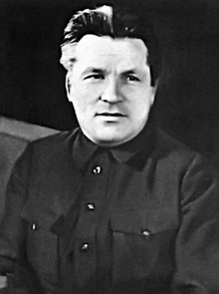
What changed?
After the murder of Sergei Kirov in 1934, the purges changed. From 1936-38, many old Bolshevik leaders were murdered, the party itself was purged ruthlessly and violently and other groups were targeted in society.
There are 3 phases in the purges of the 1930s:
The chistka of 1932-35 where over 20% of party members were expelled non-violently.
The show trials which saw old Bolsheviks publically tried and executed.
The Great Terror of 1937-38 when 1000s of party members, officials, armed force and professionals were denounced, arrested and executed.

Slide 6
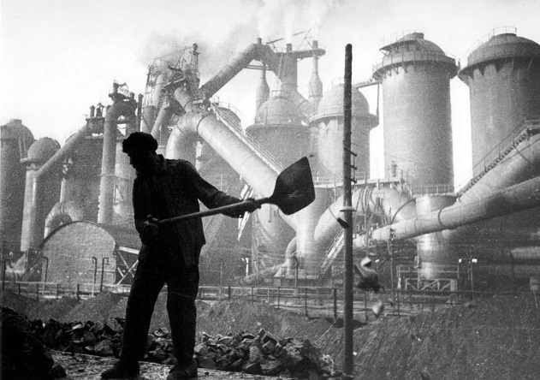
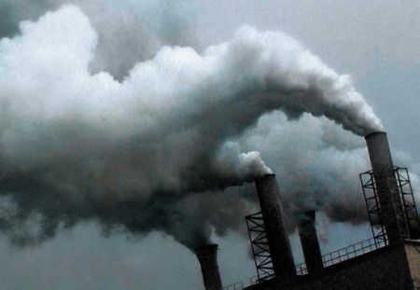
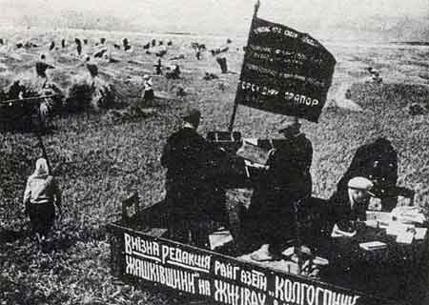
Why was the Party unpopular?
By 1933, the Communist Party was extremely unpopular. Rapid industrialisation had created tension and stress in society which put a strain on relations between the party and the people.
The violence of forced collectivisation and the famine of 1932-33 had alienated the peasantry, making the murder of rural Communist a regular event.
Urban workers were angered by low wages, strict controls and harsh punishments in the workplace.

Slide 7
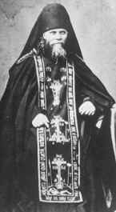
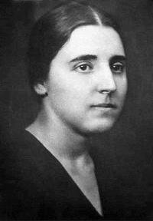
Why were Party members angry?
The cities were overcrowded, insanitary, and violent. Hatred was high among ‘former people’ such as priests, industrialists, traders and ‘bourgeois specialists’.
Most party members were becoming disturbed by the disaffection in the cities. Many were horrified by the terror methods used to collectivise agriculture, and the waging of war on the peasants.
This was not the road to socialist construction that they had envisaged. Some event committed suicide, including Stalin’s wife, Nadezda Allilueva.

Slide 8
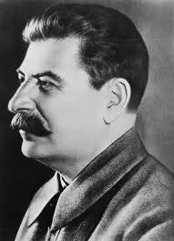
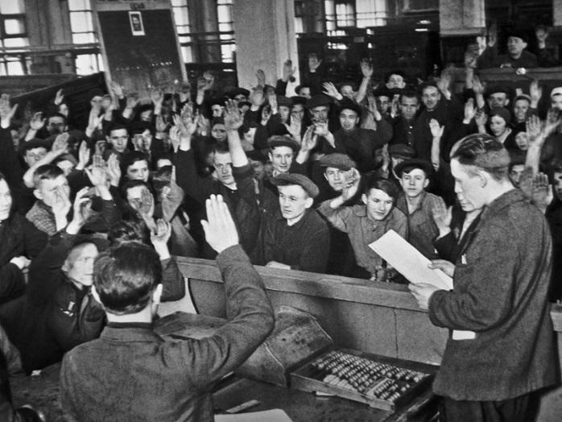
Opposition in the Regions
Stalin’s policies of rapid industrialisation and collectivisation brought dissension in the party at large in the regions of the USSR.
Local party members were unwilling to implement central policies and orders. They argued about high grain collection targets, were unwilling to identify kulaks or get rid of specialists who might help them reach production targets.
Most hated the degree of terror the central government demanded.

Slide 9
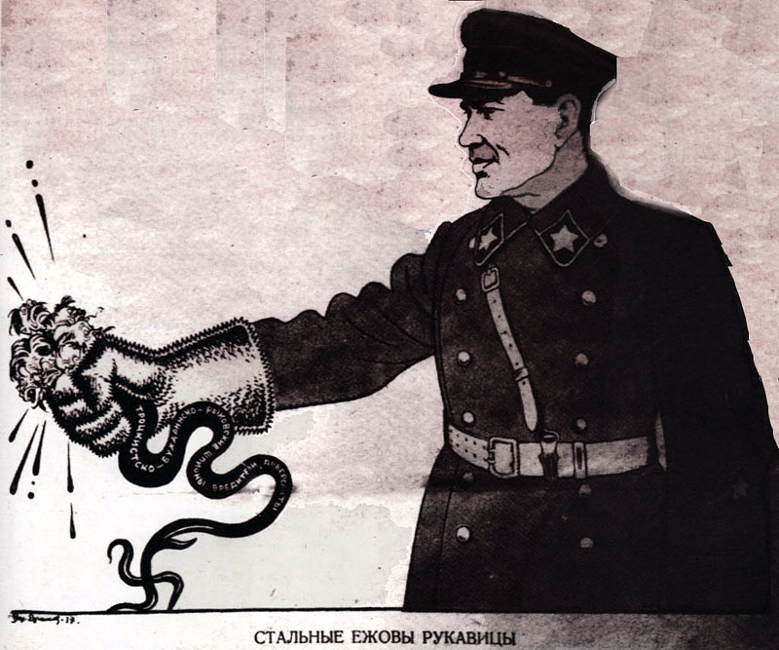
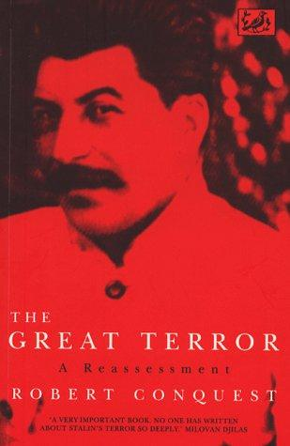
Early Purges 1932-35
Party leaders became angry with this lack of party discipline. In December 1932 they launched a Chistka (cleansing/purge) of party members.
Its target was party members who, ‘do not carry out decisions…and who are turncoats who have allied themselves with bourgeois elements.’
By 1935, 22% of party members had lost their membership. It was also used to expel those who disagreed with Stalin’s party line.

Slide 10
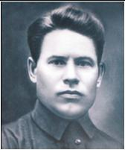
The Ryutin Affair
There was also signs of opposition within the Politburo. In 1932, former Moscow Party Secretary, Ryutin, circulated a 200-page document highly critical of Stalin.
He called Stalin ‘the evil genius of the Russian revolution’. Referring to his ‘personal dictatorship’, he urged Stalin’s removal, and the end to collectivisation.
Stalin wanted the death penalty for Ryutin but other members of the Politburo opposed Stalin and Ryutin was not executed. This was a major blow to Stalin’s authority.

Slide 11
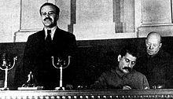
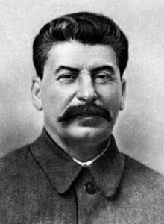
17th Party Congress, 1934
In January 1934, the front page of Pravda announced ‘Socialism in One Country has Won’. The 17th Party Congress which opened on 26th February was announced as the ‘Congress of Victors.’
There was a feeling that economic change had been accomplished and it was now possible to slow down, stabilise and reduce the tensions caused by collectivisation and rapid industrialisation.
Many wanted to reward workers with more food, more clothing and better living conditions.

Slide 12
17th Party Congress, 1934
However Stalin made it clear that he would not slacken the pace of industrialisation. This opened up a split between Stalin and other leading members of the Politburo.
Sergei Kirov, the popular Leningrad Party Boss, said ‘The fundamental difficulties are behind us’ and went on to talk about stopping grain seizures from peasants and increasing workers rations.
He even received longer standing ovations than Stalin!

Slide 13
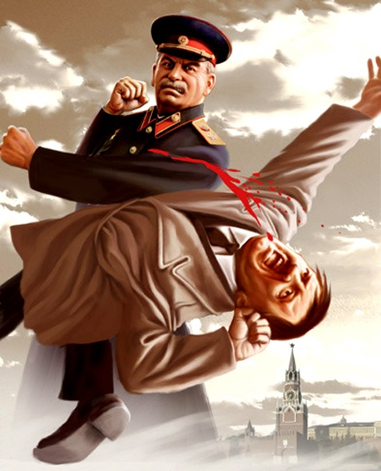
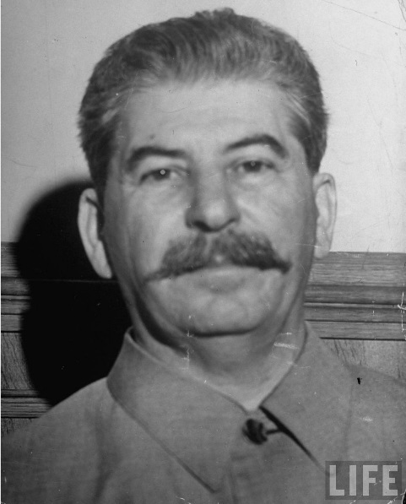
17th Party Congress, 1934
There is even evidence to suggest that provincial party delegates asked Kirov to take over as General Secretary from Stalin but he refused – but Stalin was under threat.
He even did badly in elections to the Central Committee. Kirov apparent received all but 3 of the 1225 votes – 300 did not vote for Stalin.
The Congress also abolished the post of General Secretary. In principle, Stalin was no more important than Kirov.

Slide 14
What sort of opposition to Stalin had developed before 1934?
Using today’s notes and pages 34-35, write a paragraph explaining what opposition Stalin faced before 1934 and why. Consider:
Why the Communist Party was unpopular with the people
Why many Communist were distressed by Stalin’s policies
What opposition Stalin faced in the regions
The Chistka of 1932-35
Opposition within the Party leadership
Stalin’s difficulties at the 17th Party Congress

