Slide 1
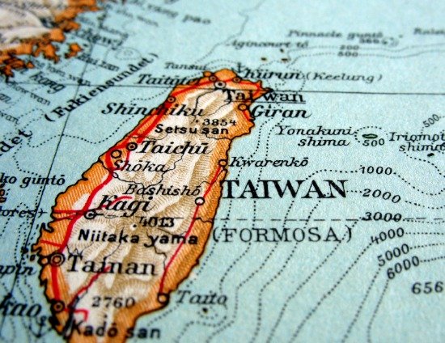
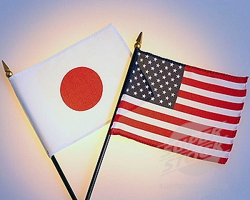
Why was Containment a Success in Japan and Taiwan?
L/O – To identify the reasons for the success of containment in Japan and Taiwan

Slide 2
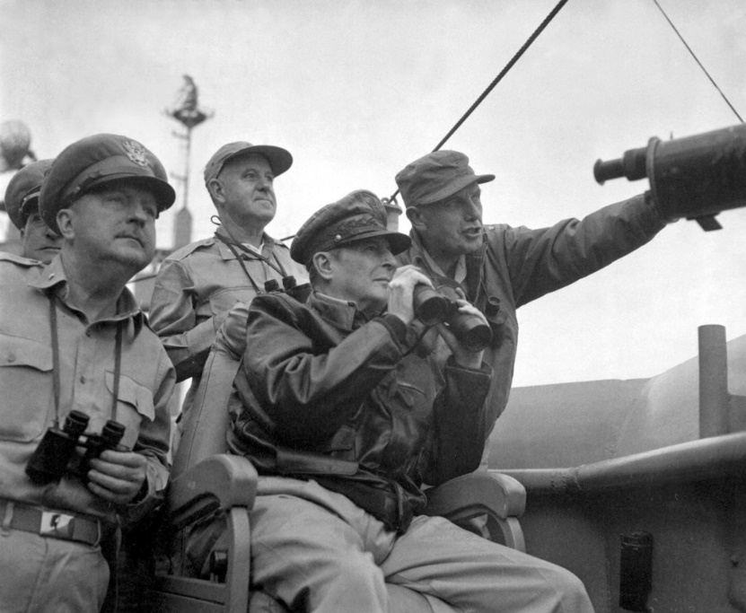
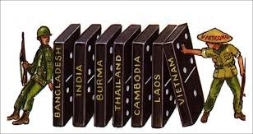
The Cold War comes to Asia
The Korean War was a significant turning point. It marked the expansion of the Cold War into Asia.
The USA now feared the ‘domino effect’ – Communism had to be contained before it could spread to other countries.
In some ways, Containment could be considered a success in Korea - but at huge cost. But what about in Japan and Taiwan?

Slide 3
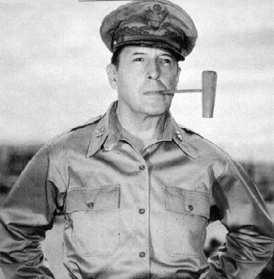
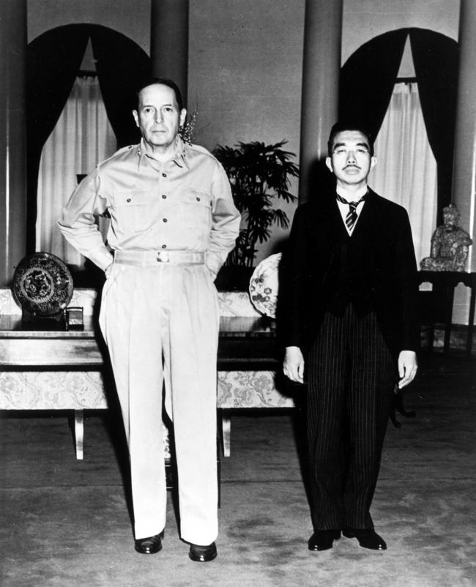
Containment in Japan
Following Japan’s surrender in 1945 the USA occupied the country, appointing General Douglas MacArthur as Supreme Commander of the Allied Powers (SCAP).
MacArthur basically had the powers of a dictator – he had full control over devising and executing policies.
The USA initially sought to de-militarise Japanese society and weaken its economy – however this policy changed as the Cold War intensified.

Slide 4
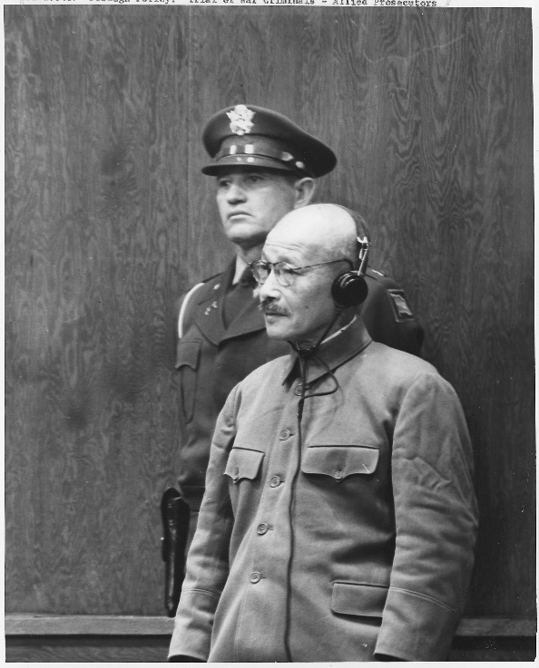
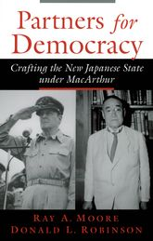
Containment in Japan
MacArthur immediately sought to dismantle the structures of Imperial Japan. Its armed forces were demilitarised and war criminals were brought to trial.
He then introduced a new constitution with a bill of rights and a clause that held Japan to ‘renounce war forever’. The Emperor was maintained however his status as a demi-god was removed.
MacArthur thus sought to turn Japan into a fully democratic society. Over 2500 political prisoners were released, including Communists. The elite ‘Zaibatsu’ families were broken up and trade unions introduced.

Slide 5
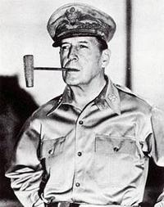
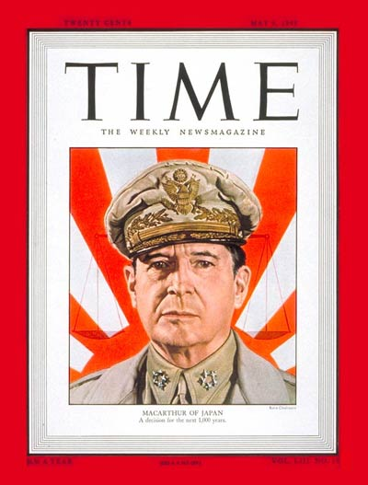
Containment in Japan
However the Korean War changed this policy. The USA now feared the spread of Communism. The USA now needed Japan to be a strong anti-Communist power to counter-balance Communist China.
The best way to ensure this was to redevelop Japan’s economy and military.
Thus trade unions were banned from striking, restrictions placed on Communists, old traditional values like duty and family promoted.

Slide 6
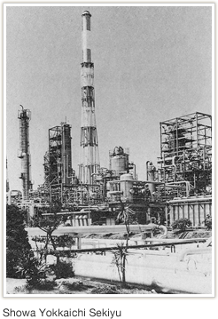
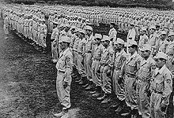
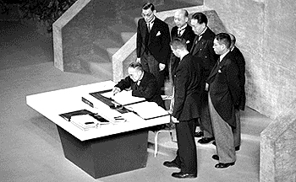
Containment in Japan
The Zaibatsu Corporations were allowed to re-form and a ‘red purge’ was announced which eliminated 1000s of left-wing officials from government. This became known as the ‘reverse course’.
During the Korean War, the USA allowed Japan to establish a 75,000 strong force called the ‘self-defence force’.
After the US occupation ended in 1952, the Treaty of San Francisco and the American-Japanese Security Treaty was signed, enabling the US to retain military bases in Japan.

Slide 7
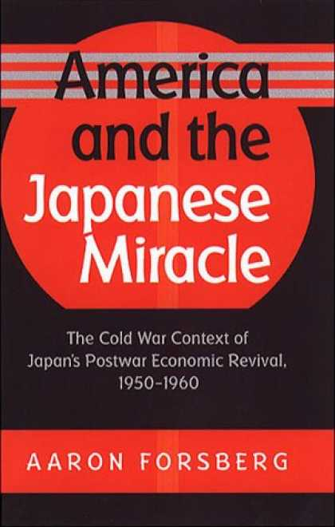
Was Containment a Success in Japan?
In short, yes – Communism never had a chance to grow in Japan. The military domination of the country by the USA and its consequent economic growth removed the conditions in which Communism could thrive.
Japan emerged as a powerful economy with a political class that was naturally conservative.
The question for historians is whether the success of containment in Japan was due to the actions of the USA or due to efforts and attitudes of the Japanese people themselves.

Slide 8
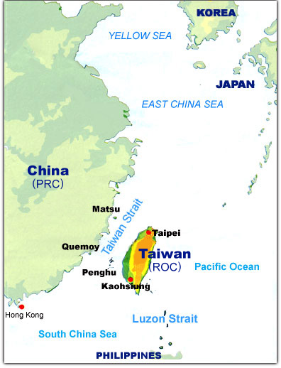
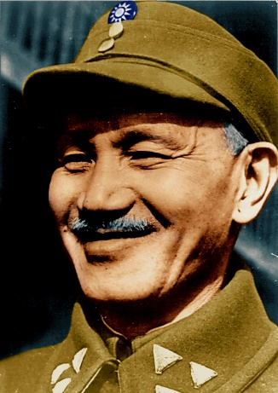
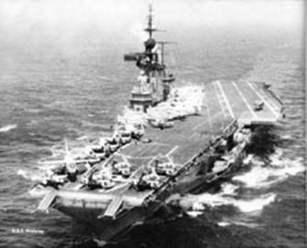
Containment in Taiwan
Before the Korean War, the USA had no formal commitments to protect Chiang Kai-shek’s KMT government in Taiwan from Communist China.
With the outbreak of the Korean War in June 1950, President Truman ordered the US 7th Fleet to the Taiwan Straights to protect Taiwan from Chinese aggression.
The USA also recognised Taiwan as the sole legitimate government for all of China and started sending substantial economic and military aid.

Slide 9
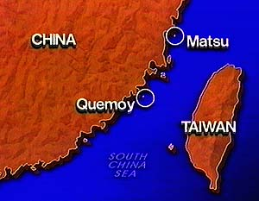
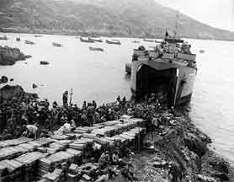
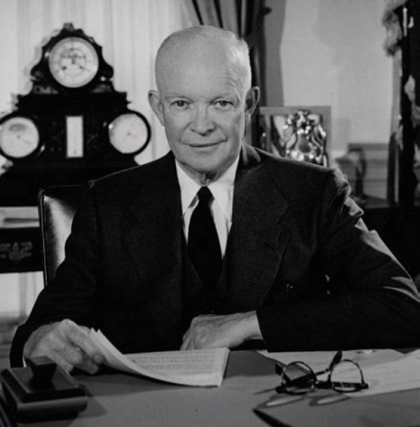
Containment in Taiwan
In 1953, under anti-communist pressure, President Eisenhower lifted the 7th Fleet’s blockade of the Straights in order to ‘unleash Chiang Kai-shek’ on the mainland.
In 1954, the KMT began to station over 50,000 troops on the islands of Quemoy and Matsu, close to the mainland. The PRC replied by shelling both islands.
The US responded to the fighting in 1955 by passing the ‘Sino-American Mutual Defence Treaty’ and the ‘Formosa Resolution’ which allowed Eisenhower to take what ever military action necessary to protect Taiwan.

Slide 10
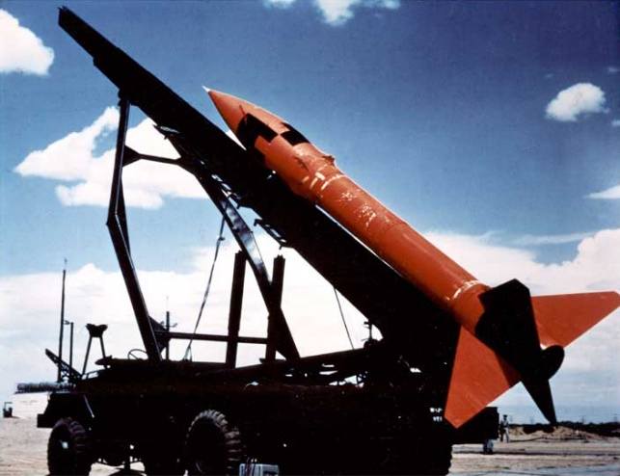
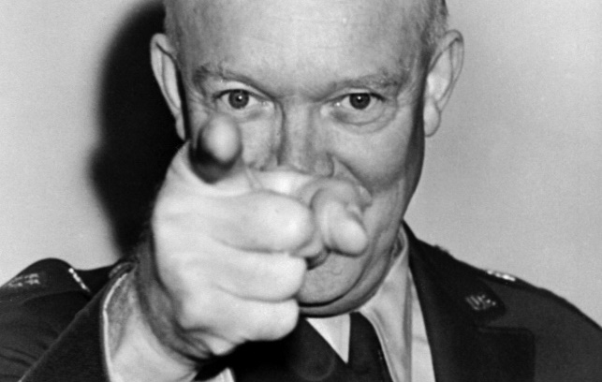
Containment in Taiwan
As fighting between the PLA and ROC intensified, Eisenhower began to threaten the use of Nuclear Weapons against mainland targets.
In the face of Eisenhower’s policies of ‘brinkmanship’ and ‘massive retaliation’, the PLA backed-down and stopped their attacks.
Another crisis erupted again in 1958 but similarly, the PRC was forced to back-down in the face of the threat of nuclear retaliation. The USSR was unwilling to risk supporting China over these two crises.

Slide 11
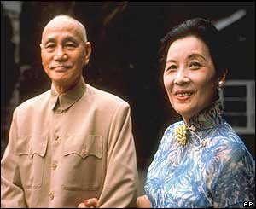
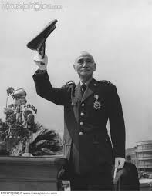
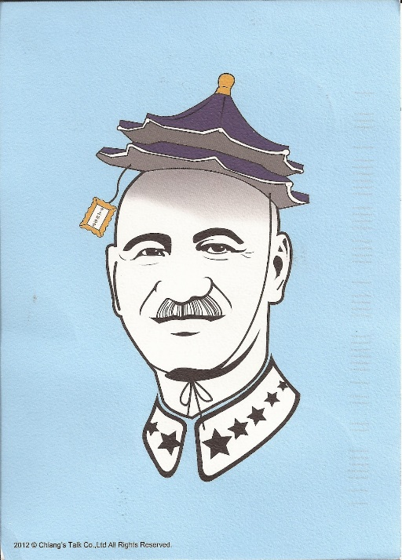
Containment in Taiwan
Whilst the USA helped to protect Taiwan against the external threat of Communism, Chiang Kai-shek quickly constructed a system of one-party rule in Taiwan that crushed any domestic opposition.
From 1949 to 1987, ‘Martial Law’ was declared to suppress any political opposition. Over 140,000 were arrested.
Taiwan also embarked on rapid economic redevelopment. Backed by the USA, in the Taiwan experienced rapid economic growth becoming known as the ‘Taiwan Miracle’. In the 1960s/1970s it was the second-fastest growing economy after Japan in the region.

Slide 12
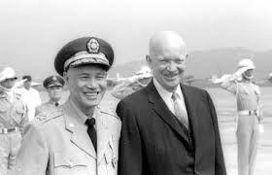
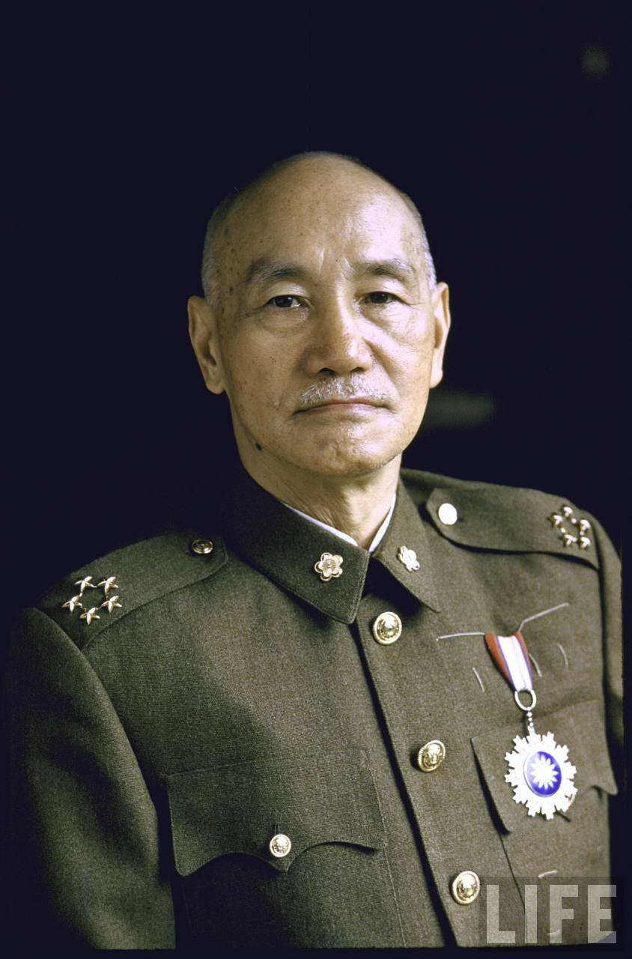
Was Containment a Success in Taiwan?
Despite the Taiwan Straights crises in 1954-55 and 1958, the US policy of ‘brinkmanship’ kept Communist China at bay.
Protected by the Sino-American Mutual Defence Treaty, Taiwan was free to develop into an advanced capitalist society.
Containment was thus a major success in Taiwan. However it is clear that without military assistance from the USA, containment would have failed.

