Slide 1
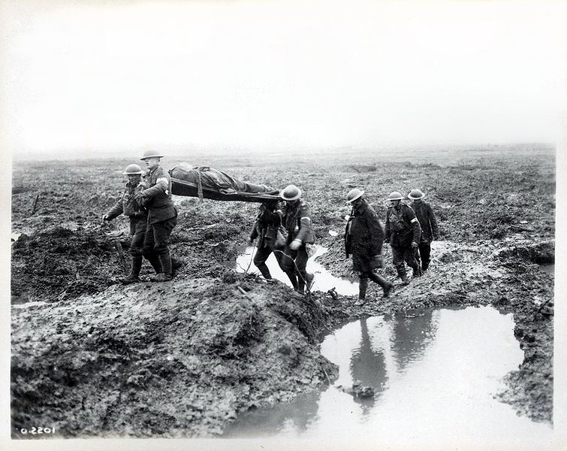
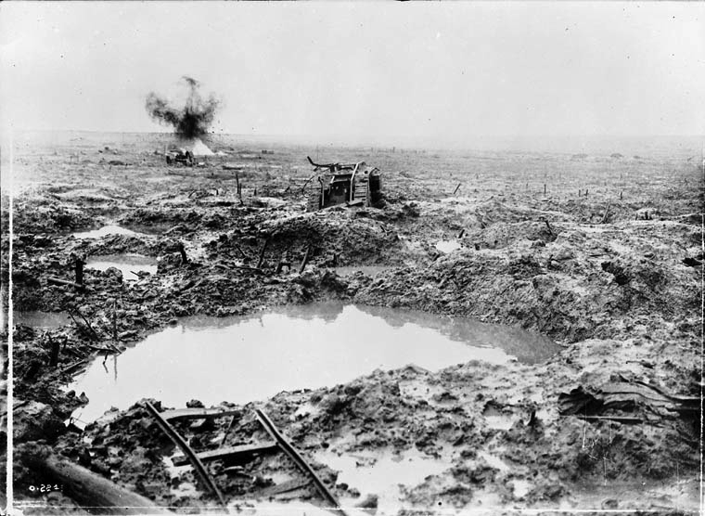
Why was the Battle of Passchendaele a disaster?
L/O – To identify and explain the reasons for the disaster

Slide 2
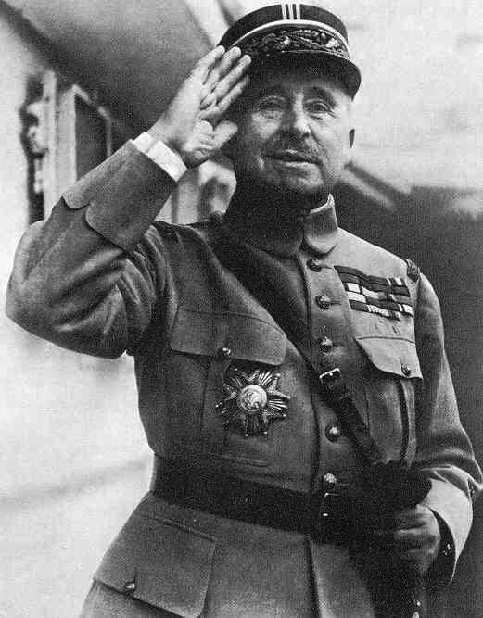
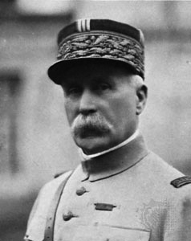
1917: Allied Collapse?
In 1917, the new French General, Nivelle, put forward a plan to break the deadlock. However the Germans knew of his plan and retreated to their stronger positions, called the Hindenburg line.
Nivelle refused to change his plans. The Nivelle Offensive, whilst successful, caused huge causalities. The French army mutinied but was successfully rallied by General Petain.

Slide 3
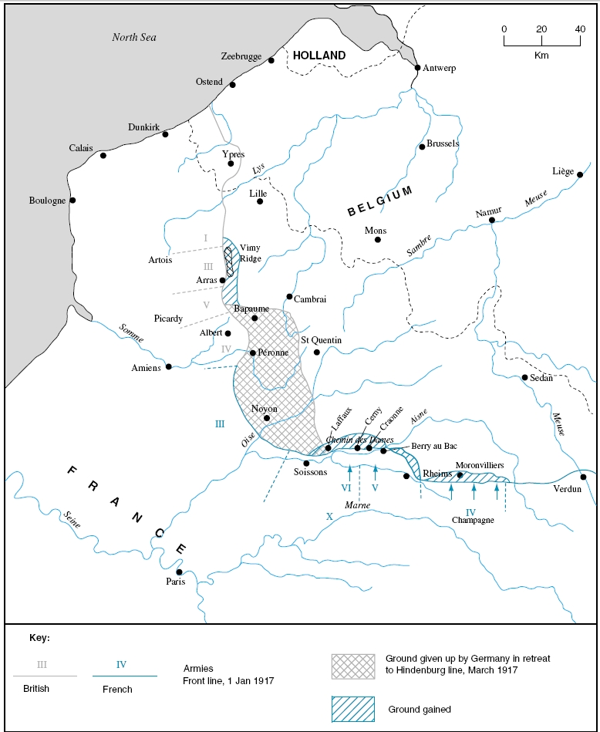

Slide 4
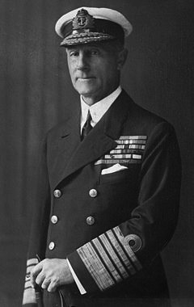
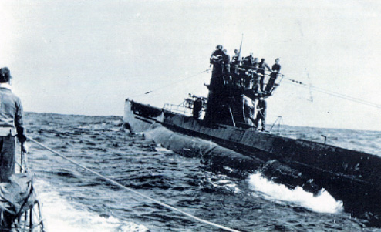
1917: Allied Collapse?
The French army seemed to be on the verge of collapse again.
The British Admiral Jellicoe had also warned that continued German U-Boat attacks on shipping, launched from Belgian bases, would soon mean Britain would be unable to continue the war.
To top it off, the Russians were about to withdraw from the war.

Slide 5
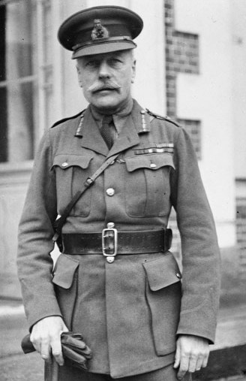
Planning the Flanders Offensive
Clearly, something had to be done to regain to offensive. Enter Haig. Again.
Haig had long planned a major ‘war-winning’ offensive in Flanders (Belgium). It was meant to happen in 1916 but was delayed by the Somme.
Haig was determined to press ahead with plans for a Flanders Offensive in late summer, 1917.

Slide 6
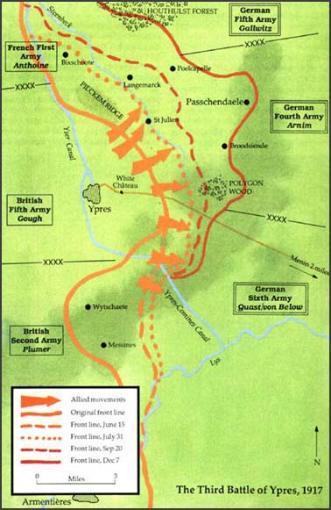
Aims of the Flanders Offensive
The two main aims of his campaign were to:
Capture and destroy German submarine bases on the Belgian coast.
Break the will of the German army which he believed was near collapse.
The British Prime Minister, David Lloyd George, did not agree with the plan but had the support it as there was no alternative plan.

Slide 7
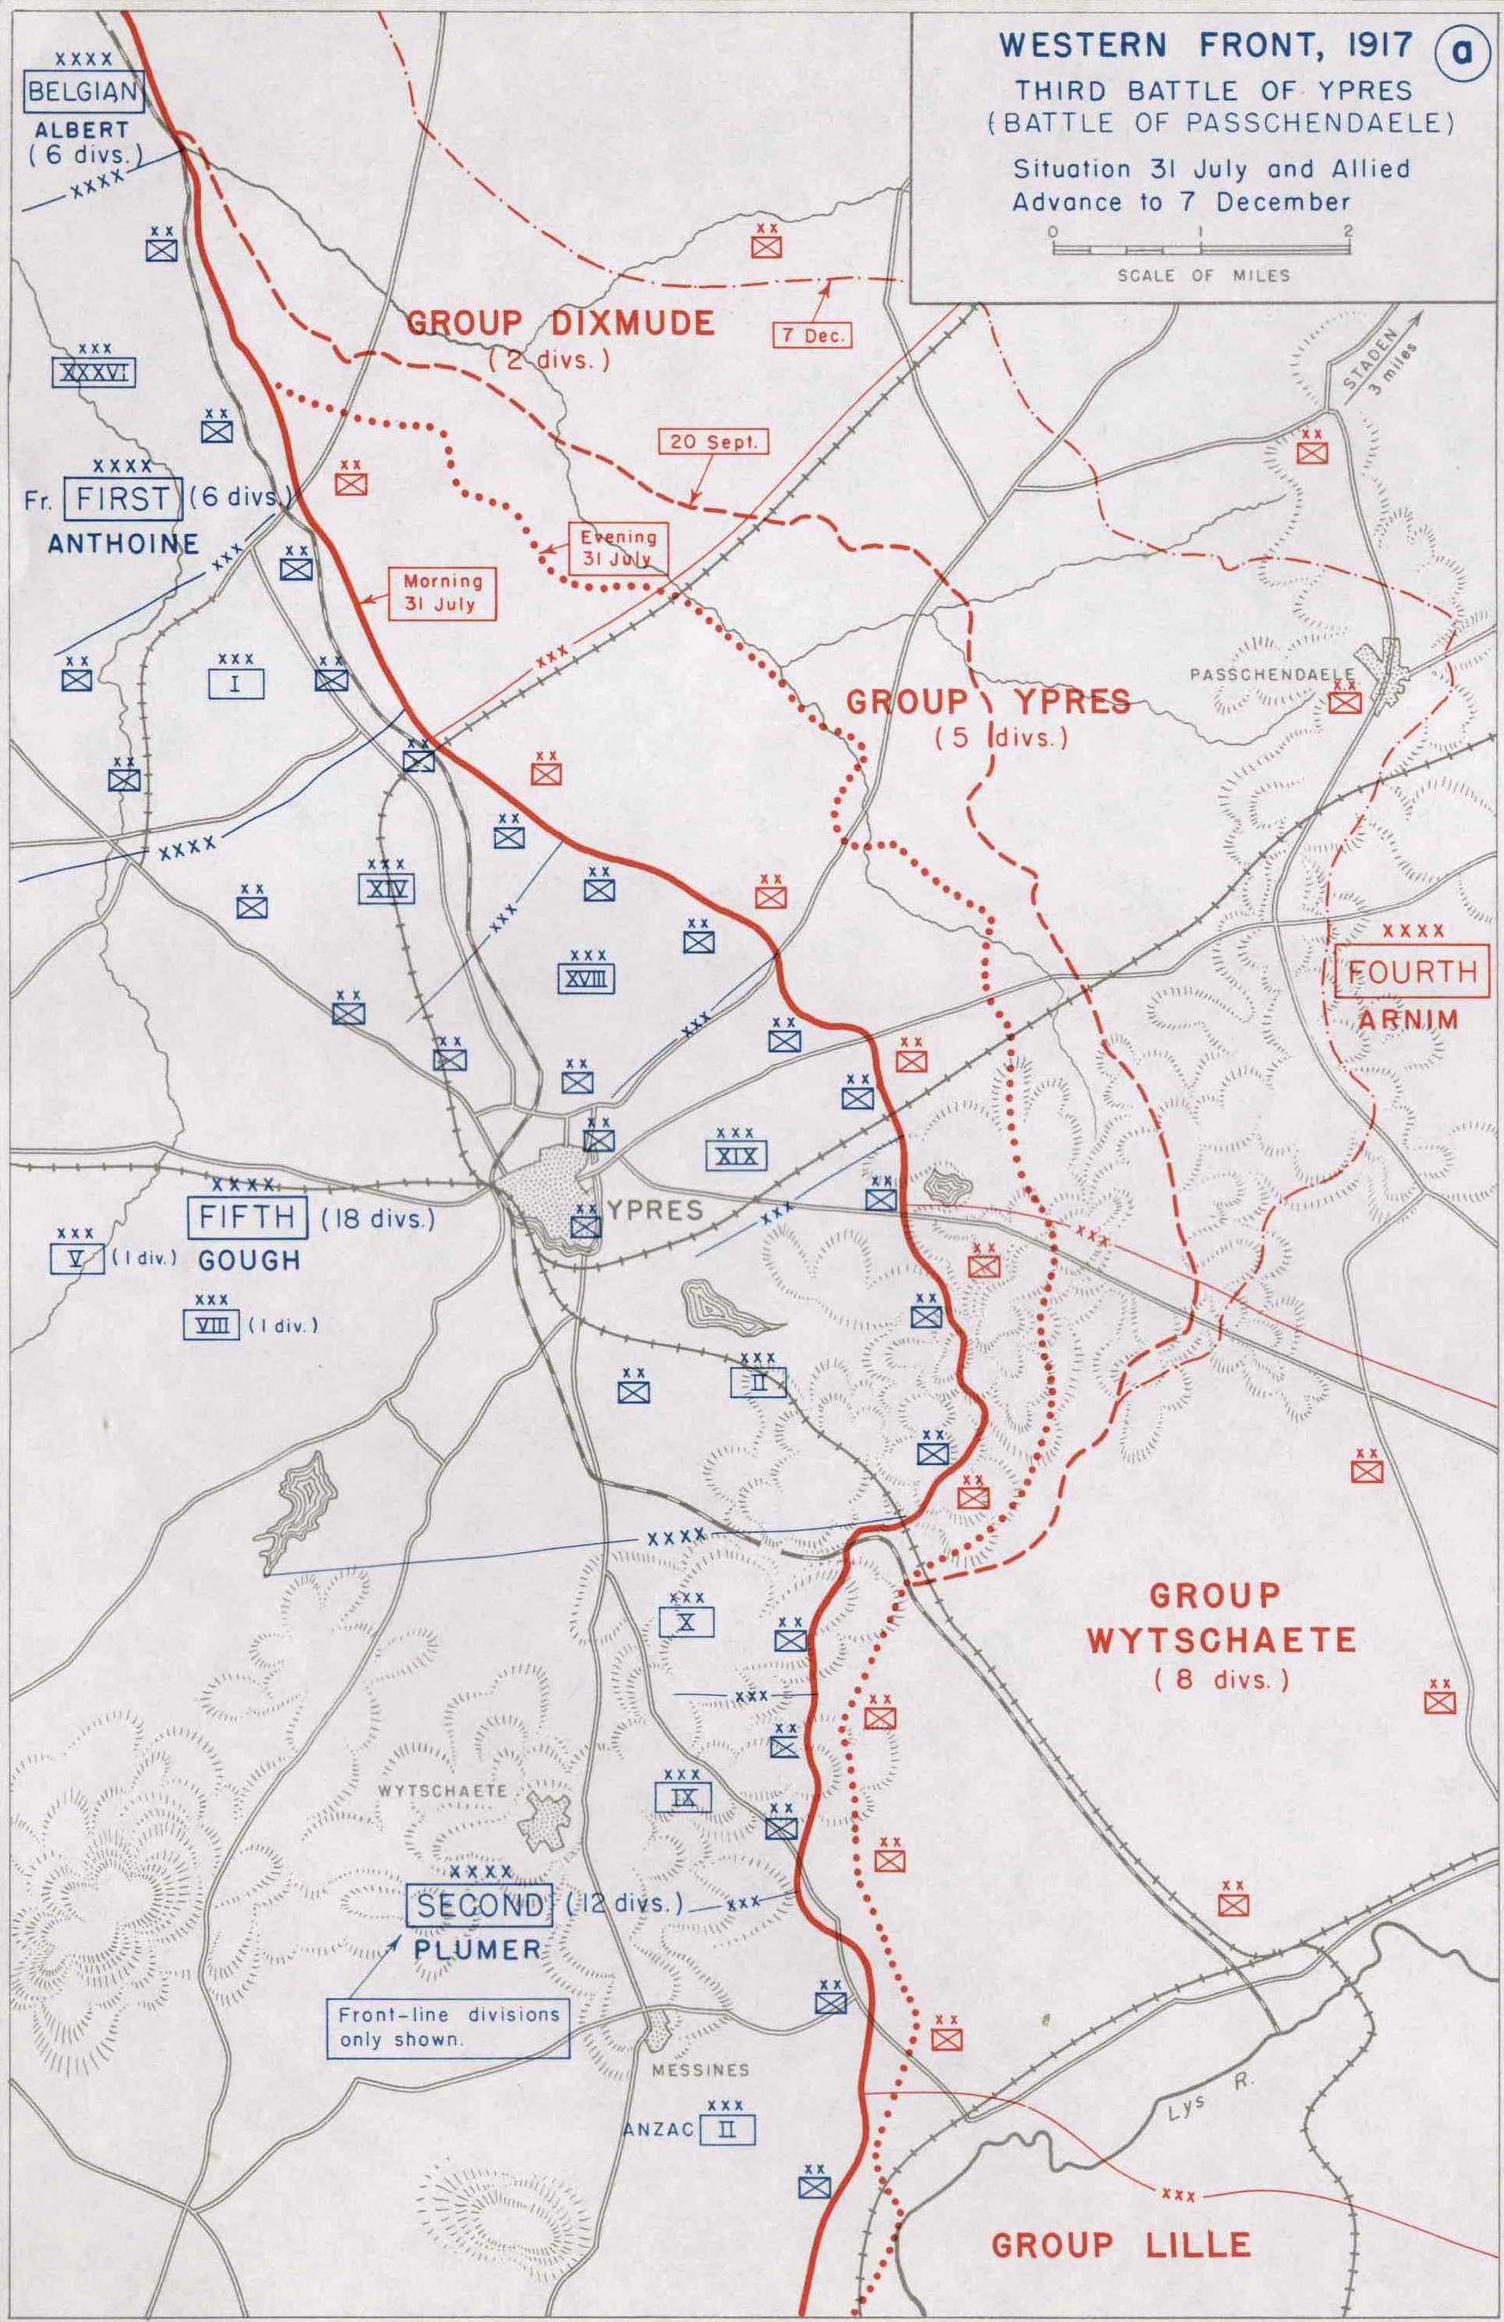
The Battle of Passchendaele
The plan was to capture the German lines on ridges and hills surrounding the Allied controlled Belgian town of Ypres.
They would then capture the village of Passchendaele and press on into Belgium, capturing the German submarine bases.

Slide 8
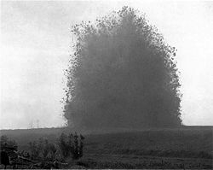
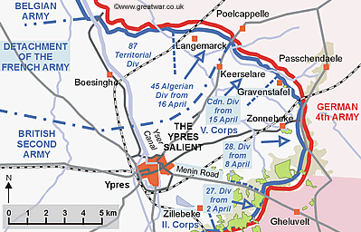
Terrain of the Ypres Salient
The flatness of the terrain and the fact that the German’s overlooked Ypres meant that the German’s knew the British attack was coming.
Who’s mistake was this?

Slide 9
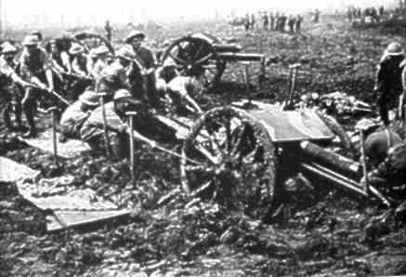
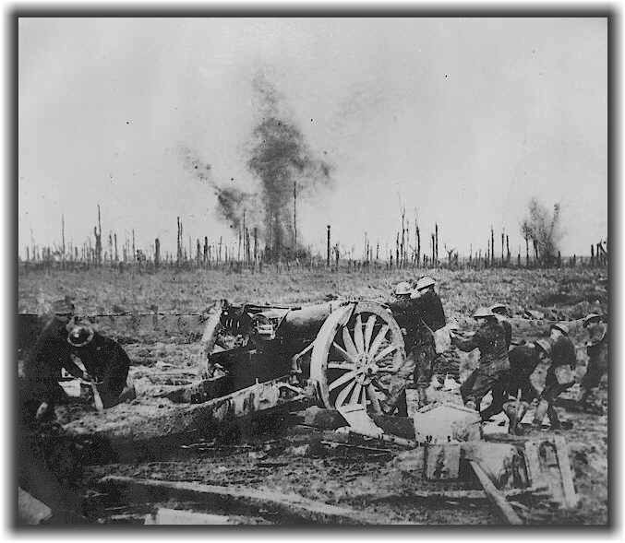
The Preliminary Bombardment
Despite this, an initial bombardment of over 4.5 million shells from 3000 guns was launched on 18th July 1917.
This lasted for 10 days and the element of surprise had definitely been lost. It has also failed to destroy the heavy German defenses.

Slide 10
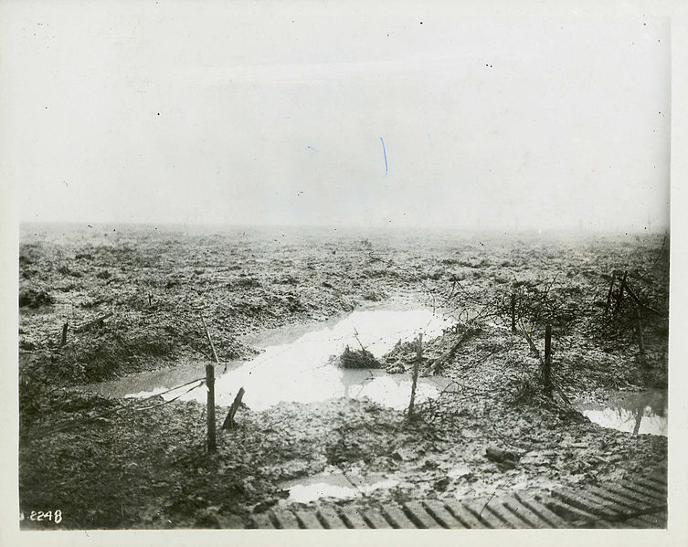
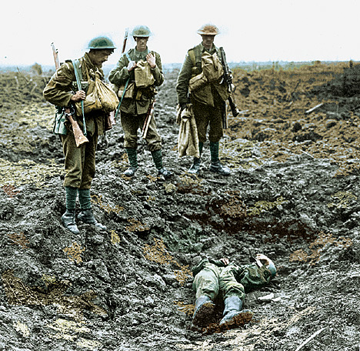
The Infantry Attack
The infantry attack started on July 31st 1917. Constant shelling had churned the clay soil and smashed the drainage systems.
There were some initial gains but within a few days, the heaviest rain for 30 years had turned the soil into a quagmire.

Slide 11
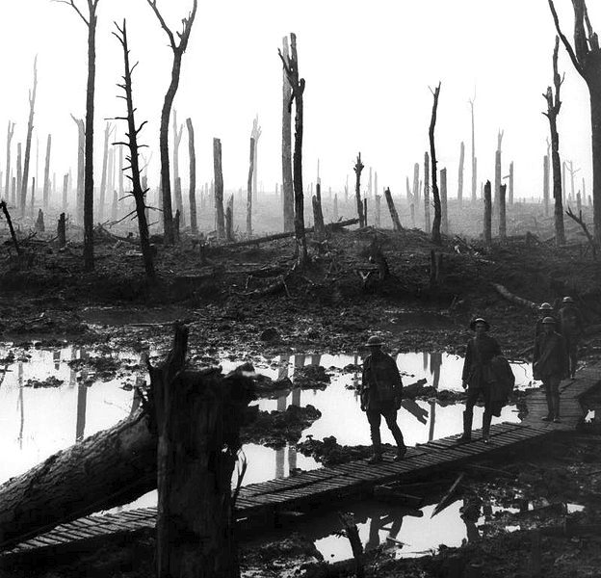
The Weather
Thick mud clogged the rifles and immobilised tanks. Even men and horses drowned in the mud.
Shells holes just filled with water and provided no cover for advancing troops who couldn’t keep up with the creeping barrage and were gunned down in their thousands.
Rain meant planes could not spot artillery targets for the British as well.

Slide 12
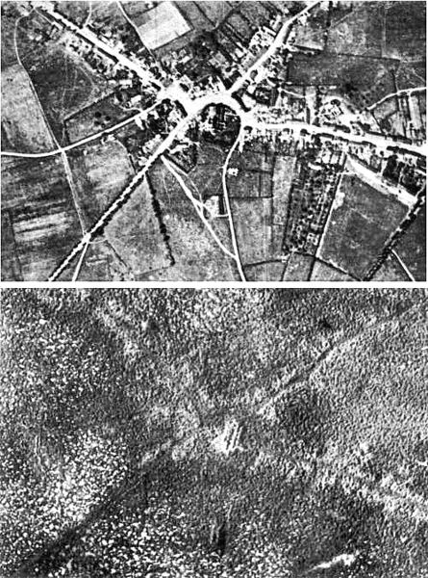
Eventual Success?
The attacked resumed on 16th August but stalemate reigned until 20th September when the British finally captured the ridge overlooking Ypres.
The eventual capture of what remained of Passchendaele village on 6th November gave Haig an excuse to call of the offensive.

Slide 13
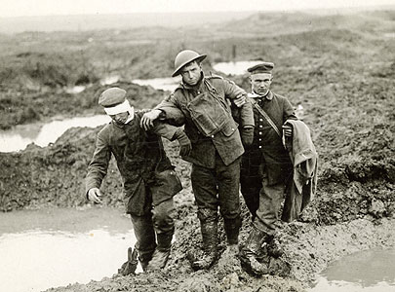
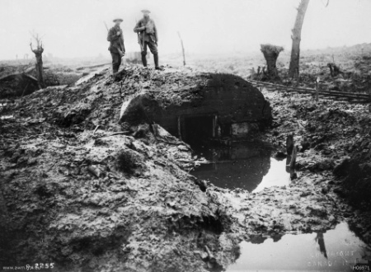
The Results of the Battle
The Allies had captured five miles of land which took 3 months.
325,000 Allied Casualties.
260,000 German Casualties.
Haig came under intense criticism for not abandoning the attack when it became clear that a breakthrough was not possible.

Slide 15
‘Haig was entirely to blame for the disaster at Passchendaele.’ – Do you agree? Give reasons for your opinion, showing that you have thought about both sides of the debate
Yes
No
Should have called off offensive earlier than November.
Main attack should have been at the Messines Ridge which was already destroyed.
Refused to modify his plans.
Gave away element of surprise
Lessons of the Somme had not been learnt
Russians had withdrawn from war and BEF would have faced German reinforcements.
Britain was vulnerable to submarine attacks – something had to be done.
Something had to be done to support French morale.
Poor weather could not be predicted.
German’s could not afford the loss of men like the Allies could

