Slide 1
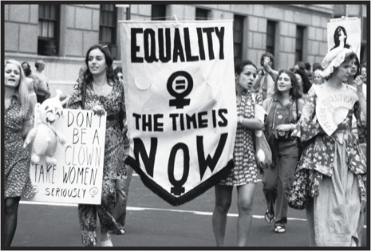
How and Why did the Women’s Movement emerge?
Reasons for the emerging women’s movement

Slide 2
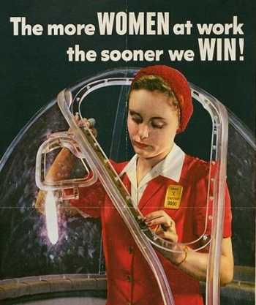
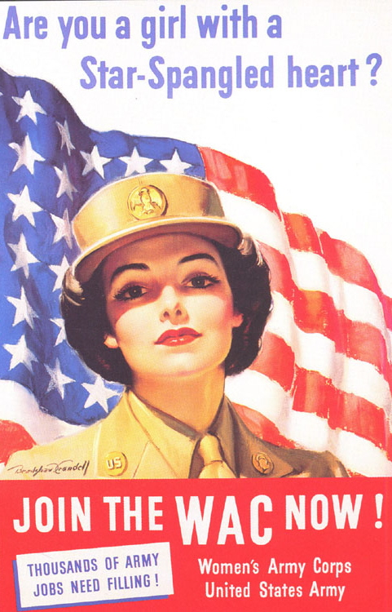
1. Rising Expectations
Women from middle-class backgrounds became increasingly frustrated with life as a housewife.
WW2 had shown women what they could do and many resented having to leave their jobs for the returning soldiers.

Slide 3
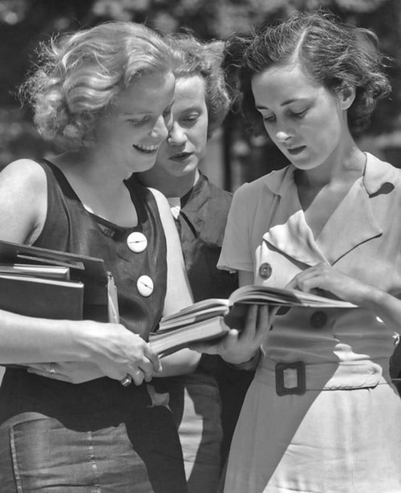
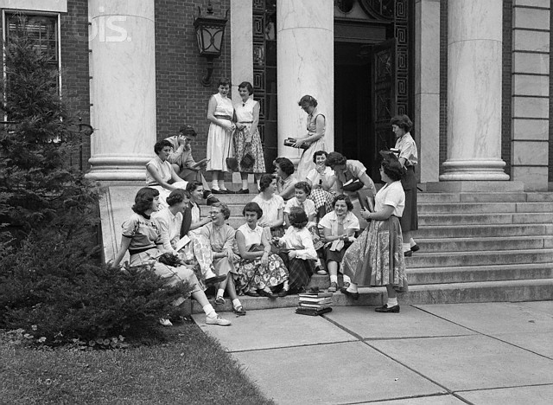
2. Education
Women became more educated as more families enjoyed bigger incomes. In 1950, there were 721,000 women at university.
By 1960, this had reached 1.3 million. Education gave women the confidence and aspirations to forge their own career paths.

Slide 4
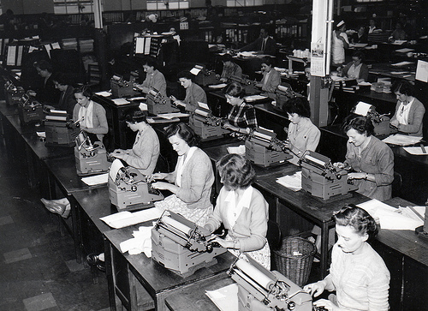
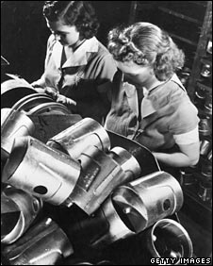
3. Employment
Despite post-war sexist attitudes, the number of women in employment actually went up! Women were seen as cheap, often part-time sources of labour.
In 1950, women made up 29% of the workforce. This had reached 50% by 1960. This gave more women financial freedom.

Slide 5
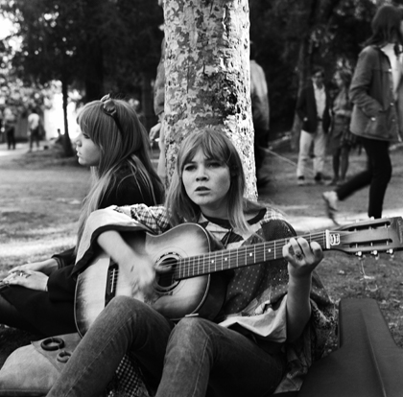
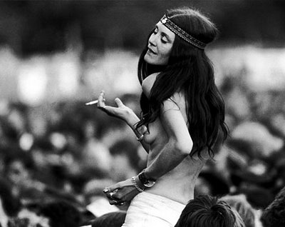
4. The ‘Swinging Sixties’
Many female teenagers were strongly influenced by the greater freedom of the 1960s and its growing counter culture.
This encouraged women to challenge traditional attitudes and roles.

Slide 6
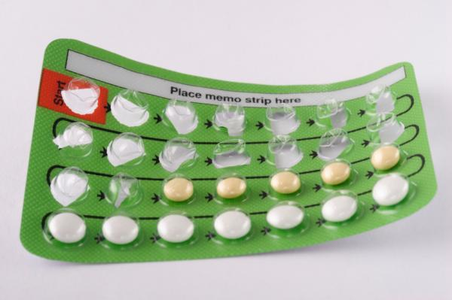
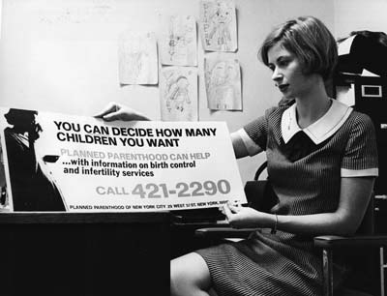
5. The Contraceptive Pill
The contraceptive pill gave females much greater choice about when or whether to have children.
This could be prevented or postponed whilst a women pursued her career.

Slide 7
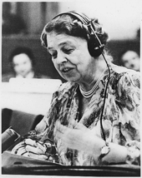
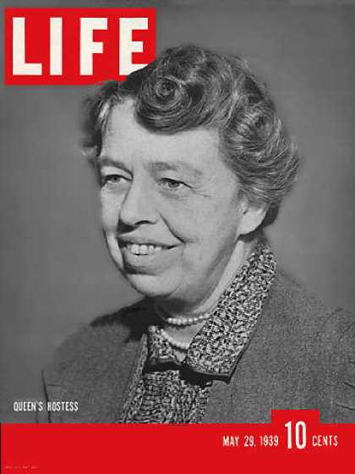
6. Eleanor Roosevelt
Eleanor was the widow of President Roosevelt (1933-45) and she campaigned tirelessly for women’s rights since the 1920s.
Her position meant she attracted publicity and she could encourage women working by holding women only press conferences.

Slide 8
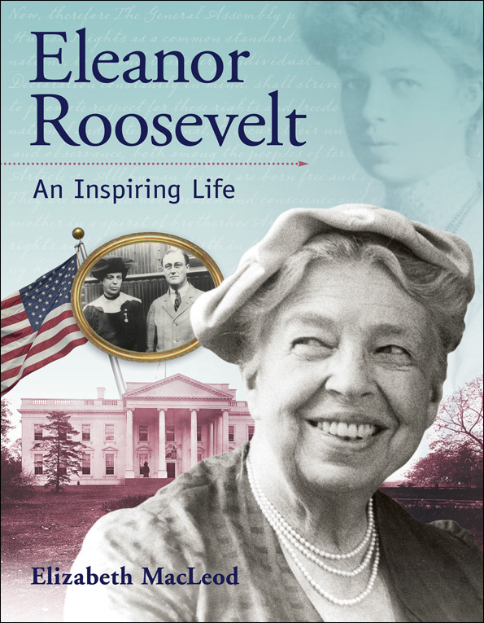
6. Eleanor Roosevelt
Her campaigns made the idea of working women more acceptable to many people. In 1960 she persuaded JFK to set up a commission to investigate the status of women at work. She was appointed Chair.

Slide 9
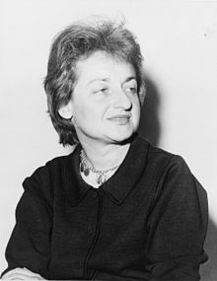
7. Betty Friedan
Betty was an author who’s 1963 book, The Feminine Mystique, expressed the thoughts of many women – there was more to life than being a mother and housewife.
She was important because she called for women to reject their traditional roles. She went on to set-up the National Organisation for Women (NOW) in 1966.

Slide 10
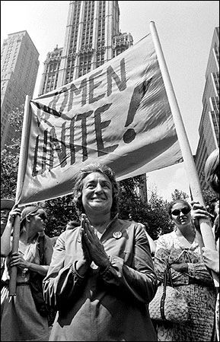
8. NOW
In June 1966, Betty Friedan and others set-up the National Organisation for Women (NOW) as a women’s civil rights group.
It’s aim was to bring women into ‘full participation in American society now, with all its privileges and responsibilities, in truly equal partnership with men’.
NOW campaigned for women’s rights across the USA.

Slide 11
8. NOW
NOWs main aims were:
1. Equal Rights in the constitution
2. Law banning sex discrimination in the workplace
3. Maternity Leave Rights
4. Child day care centres
5. Equal education
6. The right of women to control their reproductive rights.

Slide 12
Tasks
Read pages 218-219
Answer questions 1-4
Describe one effect of The Feminine Mystique on women in the 1960s. (4 marks)

Slide 13
Linking Causes
Rising Expectations
Education
A key skill in history is being able to explain how causes are linked.
Arrange each of the causes of your sheet of paper and draw lines connecting the causes that are linked.
Explain briefly next to each line why they are linked.
Employment
The ‘Swinging’ Sixties
The Contraceptive Pill
Eleanor Roosevelt
Betty Friedan
NOW

Slide 14
Exam Question
Rising Expectations after WW2
Growing access to Education
‘Why did the women’s movement develop in the USA in the 1960s? Explain your answer.’ (8 marks)
Growing female Employment gave them financial independence
The ‘Swinging’ Sixties encouraged rebellion
First Reason | Give the reason. Fully explain it.
Link | Make a link with the 2nd reason.
Second Reason | Give the reason. Fully explain it.
Conclusion | Sum up the two factors, stressing the links between them
The Contraceptive Pill gave women choice of family/career
Eleanor Roosevelt made the idea of working women acceptable
Betty Friedan’s book made women question their roles
NOW brought media attention to women’s issues

