Slide 1
What is Communism?
L/O – To identify the key features of Marxist ideology

Slide 2
Fascism
A class of political ideologies (and historical political regimes) that takes its name from the movement led by Benito Mussolini that took power in Italy in 1922. They are characterised by: militant nationalism, charismatic leaders, national unity, anti-Communism, contempt for democracy, glorification of physical strength, propaganda and a aggressive foreign policy

Slide 3
Nationalism
An ideology, or rather a whole category of similar ideologies, based on the premise that each nation (or at least the ideologist's own nation) constitutes a natural political community whose members should all live together under the authority of "their own" independent nation state.

Slide 4
Socialism
A class of ideologies favoring an economic system in which all or most productive resources are the property of the government, in which the production and distribution of goods and services are administered primarily by the government rather than by private enterprise, and in which any remaining private production and distribution is heavily regulated by the government rather than by market processes.

Slide 5
Stalinism
The method of rule, or policies, of Joseph Stalin, Soviet Communist Party and state leader from 1929 until his death in 1953. Stalinism is associated with a regime of terror aA Marxist ideology based on the theory of permanent revolution first expounded by Leon Trotsky (1879–1940), one of the leading theoreticians of the Russian Bolshevik Party and a leader in the Russian Revolution.nd totalitarian rule. Based on Marxist-Leninist principles, it came to represent whatever ideology Stalin whished it to represent.

Slide 6
Totalitarianism
A State dominated by a single, like-minded governing elite of all organized political, economic, social and cultural activities in a country by means of a single-party monopoly of power, police repression not only of all forms of dissent and opposition but also of all forms of independent private organizations as such, rigorous censorship of the mass media, centralized state planning and administration of the economy, and pervasive propaganda to inculcate the principles of the obligatory official ideology.

Slide 7
Marxist-Leninism
A variant of socialism which emphasizes that a truly communist society can be achieved only through the violent overthrow of capitalism and the establishment of a "dictatorship of the proletariat" that is to prepare the way for the future idealized society of communism under the authoritarian guidance of a hierarchical and disciplined Communist Party.

Slide 8
Maoism
A doctrine composed of the ideology and methodology for revolution developed by Mao Zedong and his associates in the Chinese Communist Party from the 1920s until Mao’s death in 1976. It has clearly represented a revolutionary method based on a distinct revolutionary outlook not necessarily dependent on a Chinese or Marxist-Leninist context

Slide 9
Leninism
A set of Marxist principles expounded by Vladimir I. Lenin, who was the preeminent figure in the Russian Revolution of 1917. Whether these concepts represented a contribution to or a corruption of Marxist thought has been debated, but their influence on the subsequent development of communism in the Soviet Union and elsewhere has been of fundamental importance.

Slide 10
Capitalism
A form of economic order characterised by private ownership of the means of production and freedom of private owners to use, buy and sell their property or services on the free market at voluntarily agreed prices and terms, with only minimal interference in transactions by the state or anyone else.

Slide 11
Imperialism
The state policy, practice, or advocacy of extending power and dominion, especially by direct territorial acquisition or by gaining political and economic control of other areas.

Slide 12
Communism
Any ideology based on the communal ownership of all property and a classless social structure, with economic production and distribution to be directed and regulated by means of an authoritative economic plan that supposedly embodies the interests of the community as a whole.

Slide 13
Trotskyism
A Marxist ideology based on the theory of permanent revolution first expounded by Leon Trotsky (1879–1940), one of the leading theoreticians of the Russian Bolshevik Party and a leader in the Russian Revolution.

Slide 14
Dictatorship
Government by a single person (or group) whose discretion in using the powers and resources of the state is unrestrained by any fixed legal or constitutional rules and who is (are) in no effective way held responsible to the general population or their elected representatives.

Slide 15
Authoritarianism
Is a form of government which is characterised by the principle of blind submission to authority, as opposed to individual freedom of thought and action. In government, it denotes any political system that concentrates power in the hands of a leader or a small elite that is not constitutionally responsible to the body of the people.

Slide 16
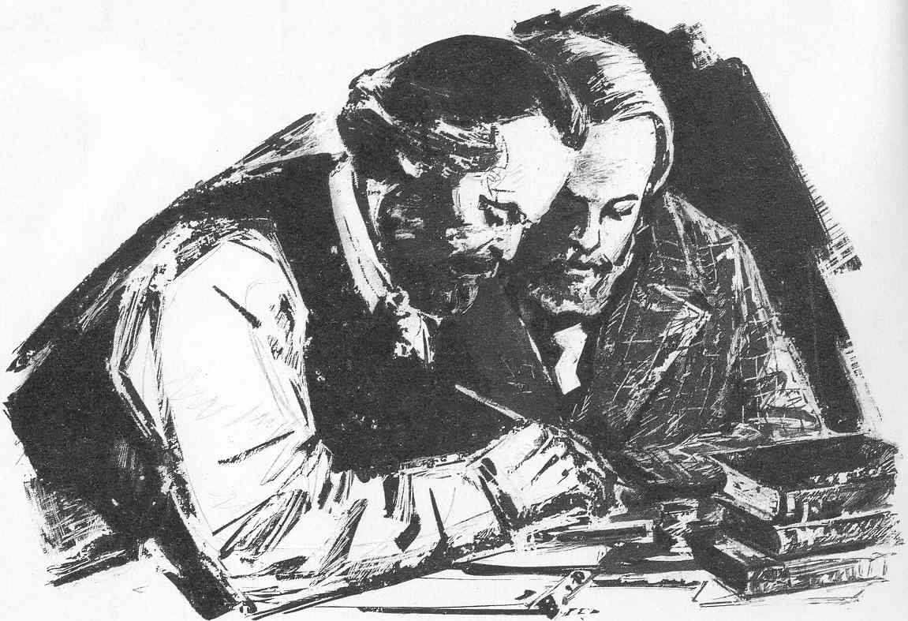
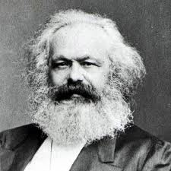
What is Communism?
The political principles of Communism were developed by Karl Marx (1818-1883) and Friedrich Engels (1820-1895) in the books Communist Manifesto (1847), Das Kapital (1867).
The writings of Marx were based on the materialist conception of history that he developed, and on his theory that human history was largely determined by the ‘history of class struggles’ between ruling and oppressed classes.
Marx believed that if the workers were successful in overthrowing capitalism, they would be able to construct a socialist society ruled by the working class.

Slide 17
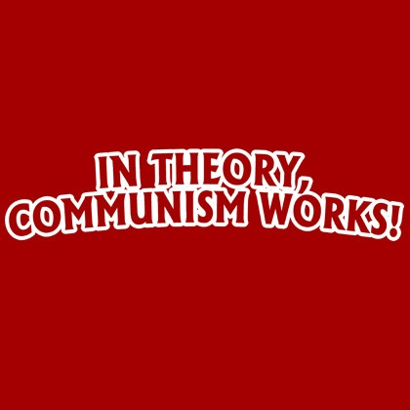
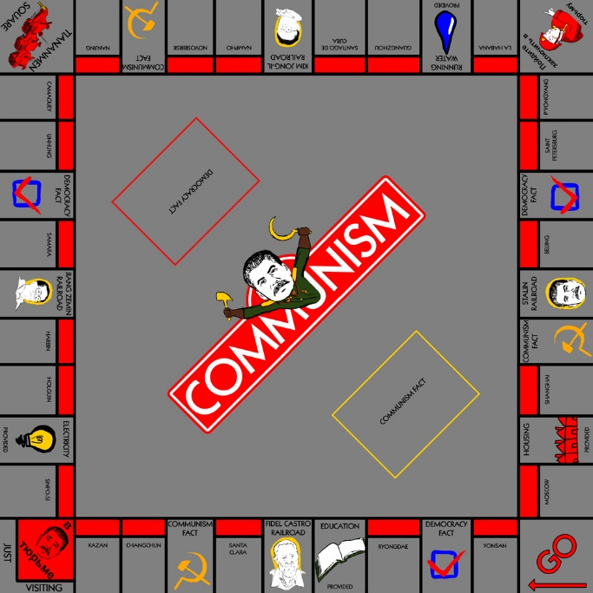
What is Communism?
From this new form of human society, Marx believed it would eventually be possible to move to an even better one: a communist society.
This would be a classless society, and a society of plenty rather than scarcity because it would be based on the economic advances of industrial capitalism.
HOWEVER! – Marx did not write much about what a communist government would look like – why is that a problem?

Slide 18
1. Marxist theory of stages
Primitive communalism
Slave society
Feudalism
Agricultural capitalism
Industrial capitalism
Socialism
Communism
Marx believed in the idea of ‘permanent revolution’ or ‘uninterrupted revolution’ - a series of revolutionary stages in which, after one stage had been achieved, the next class struggle would begin immediately.
He did not believe that ‘progression’ through the stages of society was inevitable and could actually be turned back. He even believed that a backward society could ‘jump’ a stage if aided by other countries.

Slide 19
2. Materialist Conception of History
Marx set out his theory of history in the book: Critique of Political Economy (1859). He argued that the economic structure, based on the relations of production in any society (which class owns the economy), is the real foundation of any society.
On this are built the legal, political and intellectual superstructures of society.
It was social existence that largely determines people’s consciousness or beliefs, NOT the other way around. So by changing the ownership of production, you could change history.

Slide 20
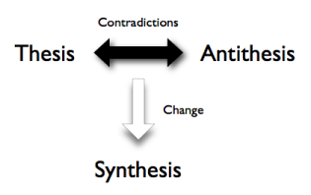
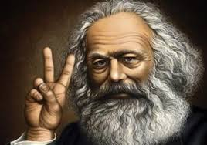
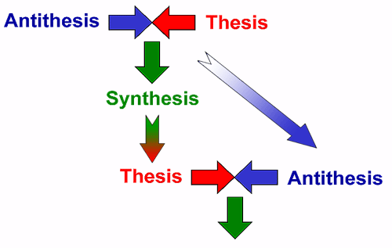
3. Dialectical Materialism
Marx’s philosophy of history was influenced by German idealist philosophy (Hegel, Herder, Kant), the ideas of French socialists (Saint-Simon) as well as the writing of British economists like Adam Smith and David Ricardo.
Dialectical (contradiction) Materialism emerged from Marx’s criticisms of Hegel’s ideas. Social relations were made up of opposite forces (thesis and antithesis). Class struggle between these poles would eventually lead to a new mode of production and a new stage in history (synthesis).

Slide 21
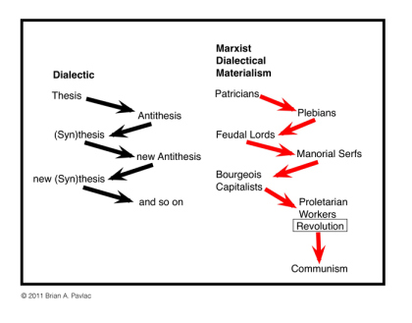

Slide 22
Plenary
Marx’s theory of dialectical materialism argued that economic systems create social beliefs and political structures (not the other way around)
Those economic systems change inevitably over time from feudal, to capitalist, to socialist, and finally communist.
Although this change is inevitable, it will take place over a long period of time, and not always painlessly: because the existing ruling class will always resist giving up their power – therefore communists advocate destroying the ruling classes!

Slide 23
‘Marxism for Dummies’
Task = Create a ‘Beginners Guide to Marxism’! This guide should be written in an engaging manner making use of analogy, diagrams and metaphor as appropriate. 2 pages of A4 maximum!
Cover the following areas:
Who was Karl Marx & How did he criticise Capitalism?
Marx’s Solution – Socialism – What was it?
How did Lenin adapt Marx’s ideas of Socialism?
What other forms of socialism are there? (Maoism, Stalinism, Trotskyism)
How can socialism be criticised?

