Slide 1
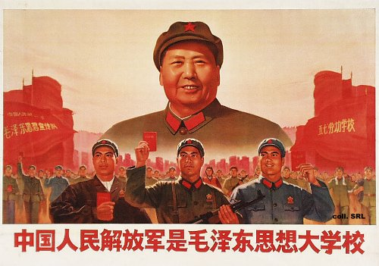
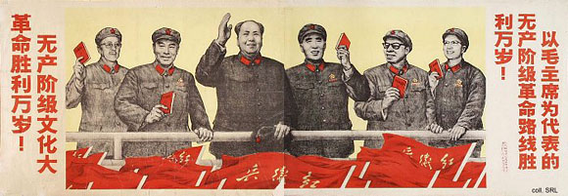
How did Mao establish a one-party state in China?
L/O – To identify and explain the political changes made by Mao in the years 1949-1957

Slide 2
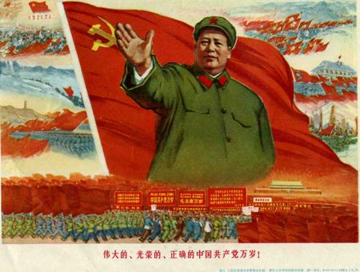
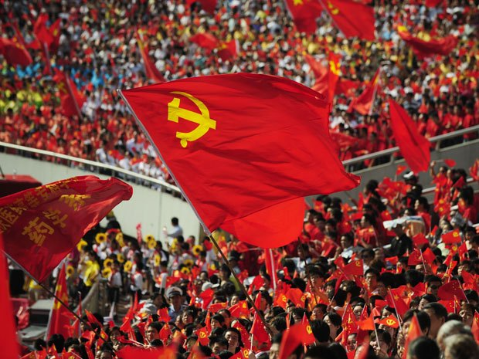
The ‘One-Party State’
From 1949 China became a one party state. All other parties were suppressed in a series of purges from 1950-1952.
Anyone who showed any opposition to communism was labelled a ‘counter-revolutionary’ or an ‘imperialist’.
To avoid accusations, Chinese increasingly tried to prove their loyalty by accusing others.

Slide 3
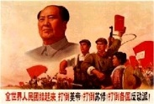
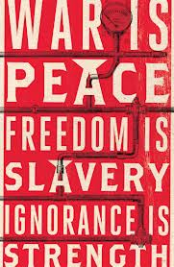
‘Thought Reform’ or ‘Thought Control’?
In 1951, the Party began a movement for ‘thought reform’. It was called the Movement for the Study of Mao Zedong’s Thought.
This involved close study of his writings, combined with public self-criticism at Party meetings.
By dominating the ideological debate and purging those people who were seen to be deviating from the correct path, Mao sought to control the Party and government.

Slide 4
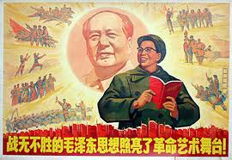
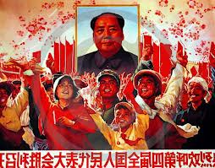
Mao Zedong Thought
Mao Zedong Thought was the official doctrine of the Communist Party, due to Mao’s influence as leading theorist.
It was a set of ideas that changed and adapted over time. Much of his ideology was based on Marxism but he adapted Marxism to Chinese conditions.
The most important ideas were self-reliance, continuing revolution, class struggle, learning from the people and mass mobilisation.

Slide 5
1.) Self-Reliance
Mao was determined that China should not be reliant on foreign powers. Even the USSR was not trusted. China should be restored as a powerful independent nation.
4.) Learning from the People
Mao believed the CCP should listen to the people. The masses should act as a check on the power of the CCP.
2.) Continuing Revolution
Mao believed that each new generation should be involved in revolutionary struggle to prevent counter-revolution & ensure support.
5.) Mass Mobilisation
Mao argued that the CCP’s main task was to mobilise the people in mass campaigns to achieve specific objectives. Mass mobilisations would be used to build infrastructure. He did not believe managers or experts were the key to economic advance. He believed people would be willing to work harder for the common good.
3.) Class Struggle
Mao worried that the CCP would become a new ruling class. The CCP had to be periodically rectified using struggle meetings, self-criticism & re-education

Slide 6
Mass Campaigns – Establishing a dictatorship?
Repression and terror were key weapons in the CCP’s struggle to control China after 1949.
The machinery of repression used by the State included propaganda campaigns to isolate and shame the chosen targets, the police, the courts, imprisonment and executions.
Between 1950-1952, Mao used mass mobilisation campaigns against corruption and the bourgeoisie – further increasing his control over society:
1950 – ‘The Three Mountains’ campaign against feudalism, capitalism and imperialism.
1951 – The ‘Three Antis Campaign’ launched against corruption, waste and bureaucracy.
1952 – The ‘Five Antis Campaign’ against bribery, tax evasion, fraud & spying.

Slide 7
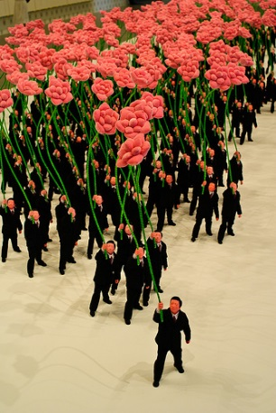
The Hundred Flowers Campaign 1956-1957
1. The leading critics were forced to retract their statements.
In 1956 Mao launched what became known as the Hundred Flowers Campaign which allowed free discussion and criticism of the government and its work.
There was a huge rush of criticism of Mao, the government and the CCP. Many people publically criticised the five year plan.
This was too much for Mao who launched an ‘Anti-Rightist Campaign’ in June 1957. Everything went into reverse and critics were persecuted.
2. Critics had to make public confessions and submit themselves to ‘re-education’. They were sent off to camps for ‘thought reform’.
3. Others were sacked from their jobs.
4. People were forbidden to speak freely and the press was censored.

Slide 8
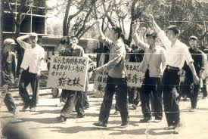
Reasons for the Hundred Flowers Campaign
There is much debate about Mao’s motives for the Campaign and historians have drawn some sharply different conclusions about Mao’s motives in launching the campaign:
One school of thought argues that he genuinely encouraged free speech and criticism but was shocked by the reaction and then clamped down on his critics.
The other school of thought believes that the Campaign was a deliberate plan by Mao to flush out critics of the government and CCP.

Slide 9
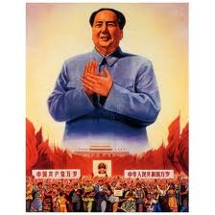
Consequences of the Hundred Flowers Campaign
Make sure you can remember at least 2 effects of the campaign:
The Hundred Flowers campaign, and the anti-rightist campaign into which in evolved , silenced criticism of the communist regime for a generation.
Party unity was strengthened.
Mao’s position was unchallengeable.
Intellectual life in China came to a virtual standstill.

Slide 10
Homework
Finish the hand-out questions.
Read pages 67-73 on ‘The Hundred Flowers Campaign’ from the A-level textbook.
Answer questions 1-4 on page 73.

